Slide 1
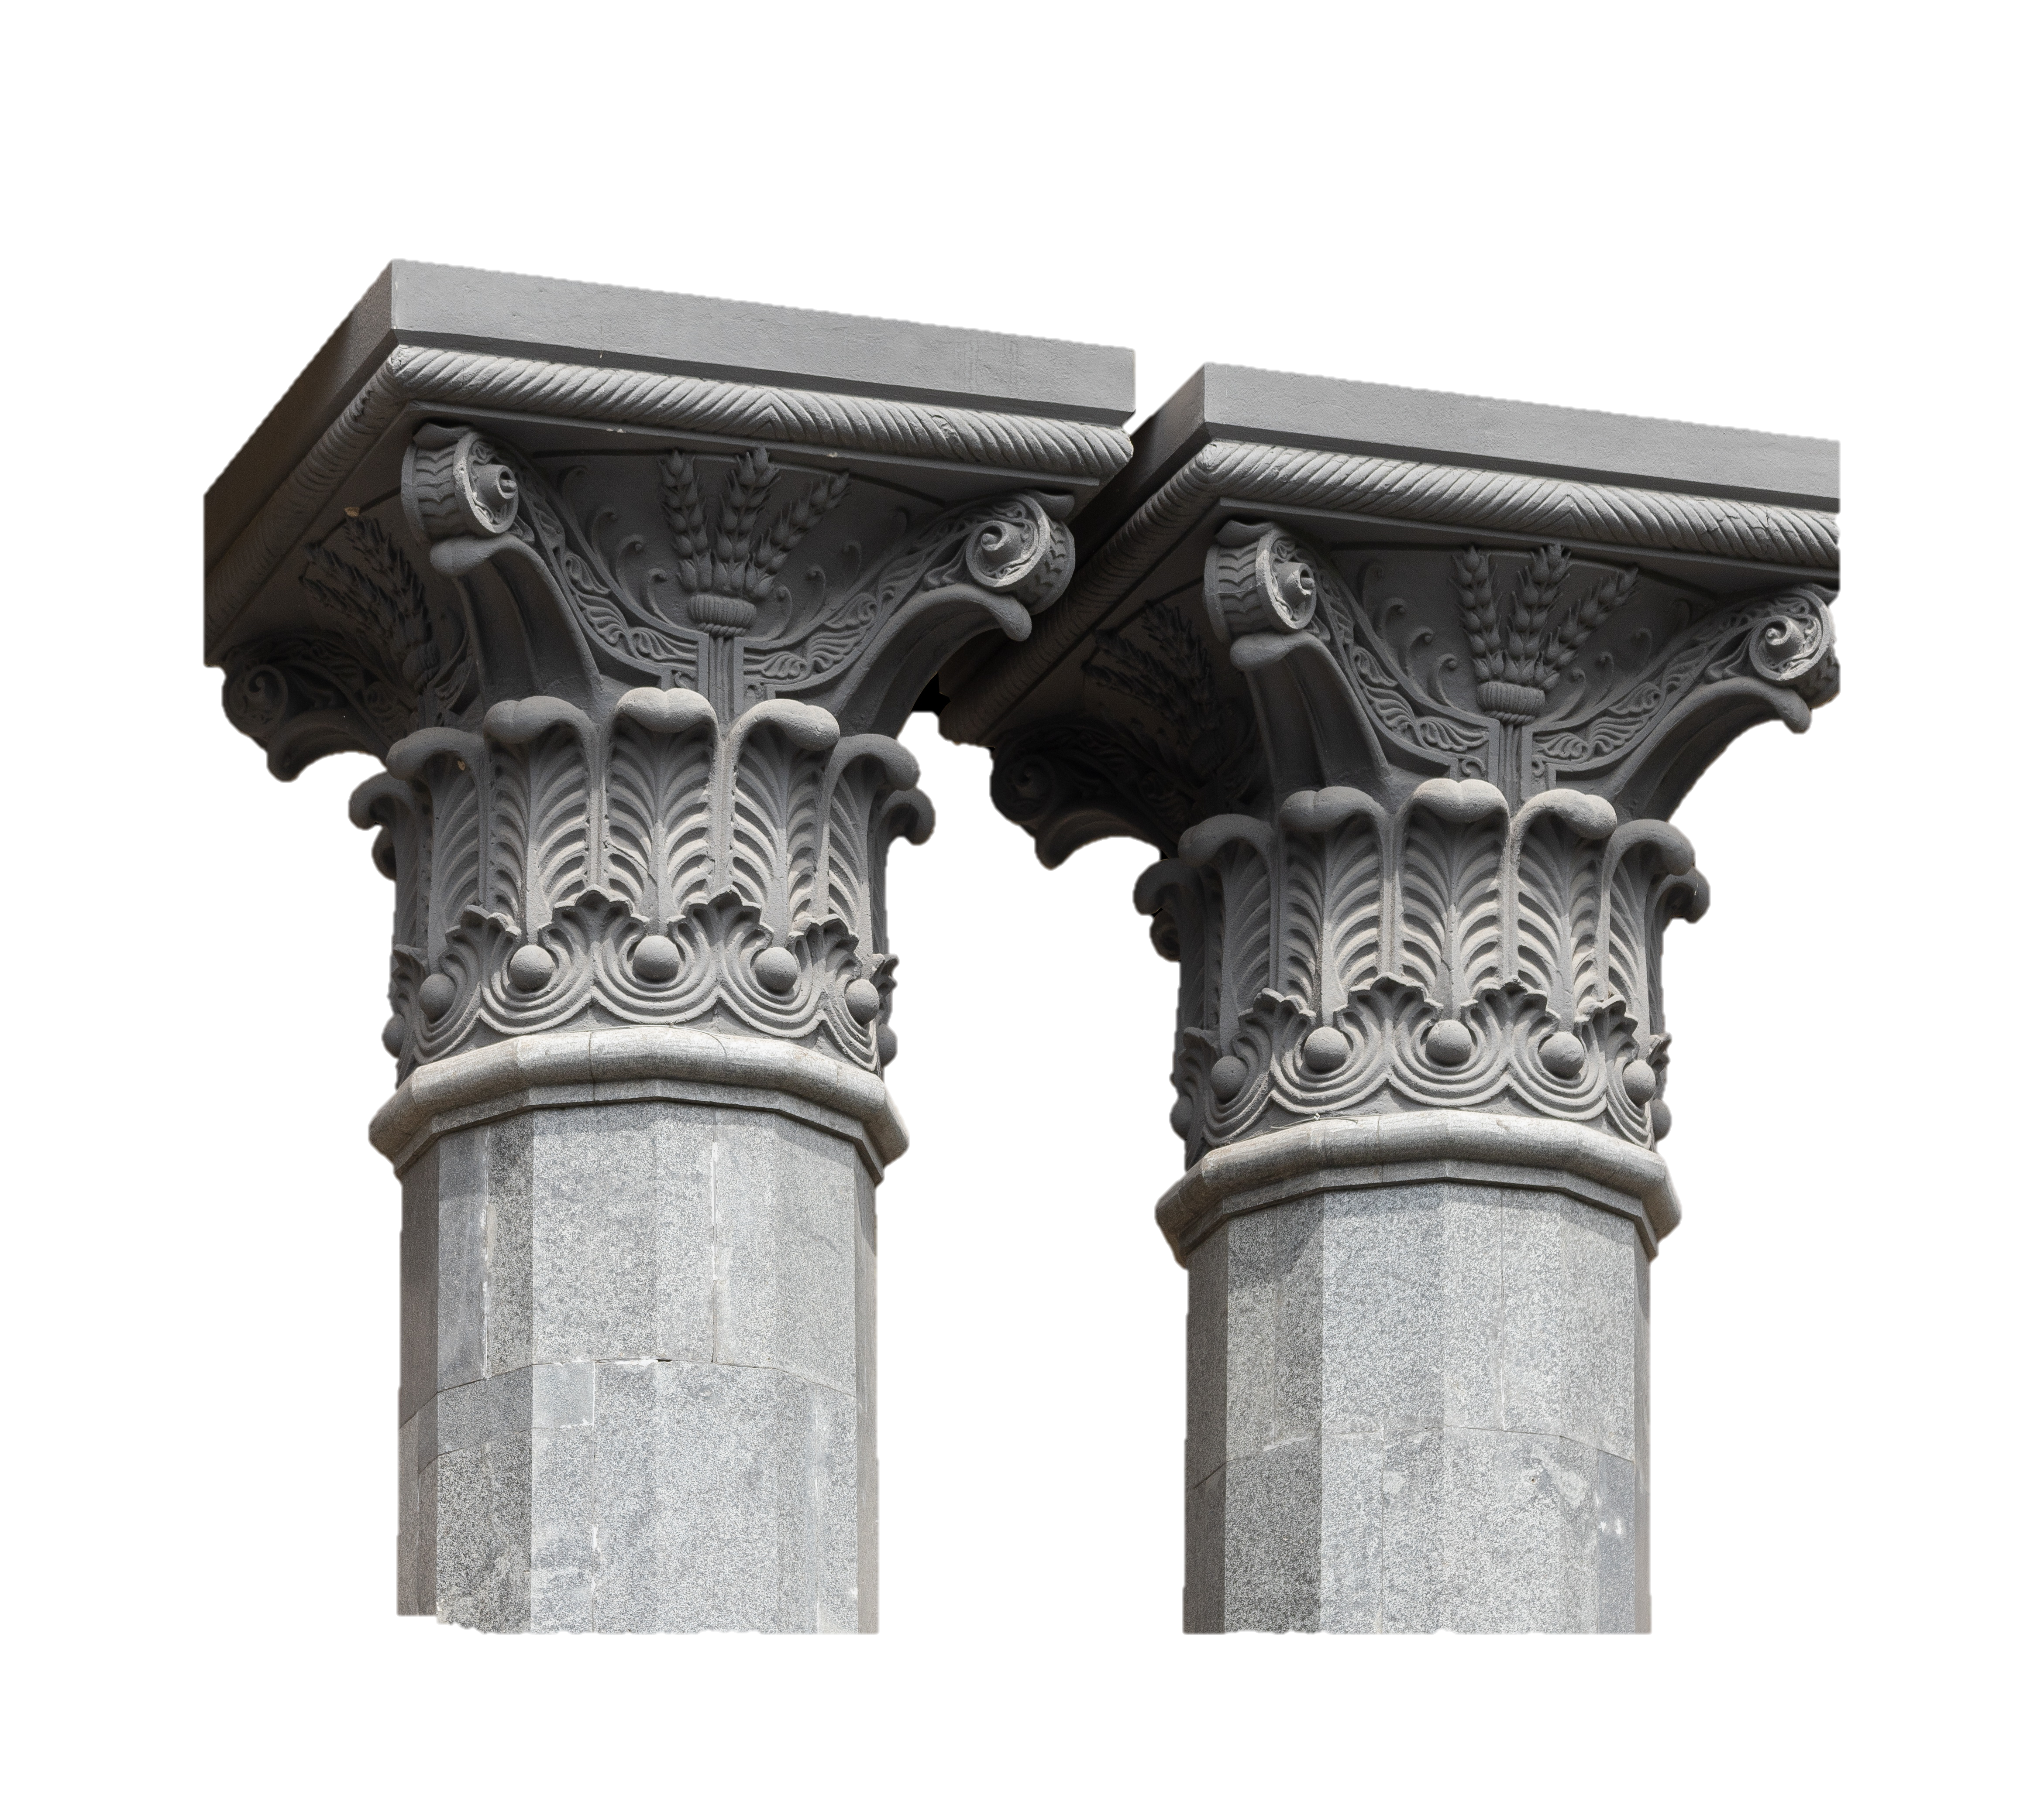

Bellringers
Exit Tickets
Activities
&
Videos
Hollywood or History? Julius Caesar & Spartacus

Slide 2


Day 1
What are three key ideas from the previous unit?
How might our previous unit help you with our current one over Ancient Rome?

Slide 3
Day 1
How has the Ancient Source Analysis Sheet helped you?
Have you ever considered these questions before when looking at sources?
What about this sheet was most surprising to you?

Slide 4

Day 2
What are the 7 categories from our primary source worksheet?
Select 2 of them and explain the main point of them with regard to collecting information from a primary source.

Slide 5
Day 2
Roman Empire, Season 2, Episode 1 Timestamps: 3:30-19:18
https://www.netflix.com/title/80096545

Slide 6

Day 2
How might you have changed the way in which the show Roman Empire presented both its dramatized recreation of events and the way they utilized their academic experts?
Think
Pair
Share

Slide 7
Day 2
How do you think tomorrow’s video will compare to this one, and why do you think that?

Slide 8

Day 3
Think back to our last lesson when we watched the clip from Netflix. How might that clip have impacted your ideas about the Romans?
What is something you learned from the video? What about from class?

Slide 9
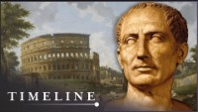
Day 3

Slide 10

Day 3
1,2,3 Activity
What is 1 thing you already knew?
What are 2 things you learned from a classmate the past 2 days?
What are 3 key ideas or points from either/both clips and our discussions?

Slide 11
Day 3
What is something you learned from today’s clip that yesterday’s clip did not tell you?
Which clip did you enjoy more? Why is that?
Which clip do you think was more convincing at presenting Caesar’s life? Use evidence from the clips to support your answer.

Slide 12

Day 4
What is something you learned from the History Hit clip?
Have your ideas and thoughts about the Netflix clip changed since viewing the History Hit clip?
Why or why not?

Slide 13
Day 4
Let’s get a head start on the Venn Diagram – name one commonality between the source and clip. Be sure to include it in your Venn Diagram!
What is something that the clip says that the source does not?

Slide 14

Day 5
After the homework assignment, did you find the source to confirm or refute your ideas from prior to the first day?
Refer back to your Venn Diagram. How do the clips compare to the text?

Slide 15
Day 5
Has this unit changed the way in which you view documentaries? If so, why or why not?
What is your key takeaway from this unit?
How might historians then construct the past if primary sources are incomplete? How would you fill the gaps with regards to Caesar and Spartacus?

